Slide 1
DESIGN AND IMPLEMENTATION OF AN ESTATE VISITATION SYSTEM
BY: SADIK HASSAN BELLO
ID: BU/22C/IT/7888
DATE: 29/09/2025

Slide 2
ABSTRACT
This project presents the design and implementation of an estate visitor management system aimed at improving communication, security, and access control in residential communities. The system enables visitors to request entry and receive QR passes, which security personnel can verify at the estate gate, ensuring a more organized access process. Through a dedicated dashboard, administrators can manage users and monitor estate activities, while residents benefit from features such as service requests and online bill payments. By integrating these capabilities, the system enhances security, improves accountability, and reduces manual operations. Overall, the project demonstrates how technology can be applied to create a safer, more efficient, and user-friendly estate environment.

Slide 3
INTRODUCTION
Estate communities face growing challenges in managing residents, visitors, and security operations safely and efficiently. In many residential estates, visitor management and communication are still handled manually, often through physical logbooks, phone calls, etc. These records are prone to errors, loss, or manipulation, which compromises estate security. For example, in cities such as Abuja, Lagos, Kano, Kaduna, Katsina, Sokoto, and Bauchi, when a visitor arrives at the gate, the security personnel must first call the resident for confirmation. In some cases, the resident has to call back to reconfirm the details before the visitor is finally allowed entry. While this process is intended to improve safety, it is time-consuming, prone to miscommunication, and inconvenient for both residents and their guests. Beyond visitor access, emergencies such as break-ins or maintenance issues are often communicated inefficiently, delaying response and putting residents at risk. These gaps highlight the need for a secure and reliable system that automates routine processes while enhancing accountability. By introducing QR code verification, role-based access, and instant push notifications, this project seeks to make estate management more proactive, efficient, and transparent.

Slide 4
PROBLEM STATEMENT
Unreliable Visitor Authentication
Slow and Inconvenient Manual Verification
Delayed Emergency Communication
Lack of a Structured Platform for Maintenance Requests
Poor Record-Keeping by Administrators
Dependence on Manual Operations
Lack of a Digital System

Slide 5
Aims and Objectives
The main aim of this research is to design and implement an Estate visitation system that enhances security, communication, and administrative efficiency in residential estates.
OBJECTIVES
• To develop a web-based dashboard for the admin to manage residents and security staff.
• To build a mobile application for residents to create visitor invites, request handyman services, and send emergency alerts and also make bill payment.
• To design a progressive web application for security personnel to scan visitor QR codes and confirm entry and also view emergency reports.
• To implement QR code generation for secure visitor authentication.

Slide 6
SIGNIFICANCE OF THE PROJECT
Enhanced Security
Efficient Communication
Convenience for Residents.
Transparency for Administrators
Better Record Keeping
Scalability

Slide 7
LITERATURE REVIEW
COMPANY | STRENGHTS | WEAKNESSES
Gate Africa | Shortens the weight at the estate gate. Enables the residents to handle guests approval directly. | It depends mostly on residents involvement. Billing and facilities administration interaction is limited.
Venco Technologies | Comprehensive facilities, billing and visitor services. An efficient administration dashboard and reporting system. | Internet dependency, hence it is less useful in places with poor connectivity. Expensive management which limits adoption to wealthy homes.
Sylogate Solutions | Low cost, which is affordable for larger market. Simple QR code system. | Limited Scalability for bigger and regularly visited estates. Does not include communication or billing features
Yardi Breeze | Cloud storage which guarantees the safety and accessibility of data. Comprehensive property management features. | Requires dependable and reliable internet. Expensive for markets in Africa.

Slide 8
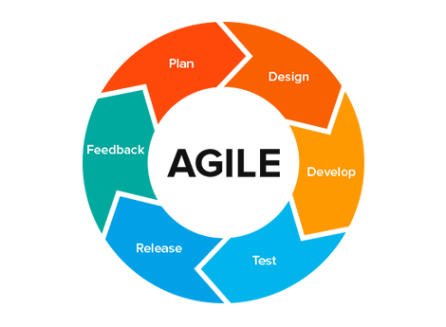
METHODOLOGY
Agile Methodology
The Agile methodology is a project management approach that breaks the project into phases and emphasizes continuous collaboration and improvement. Agile methodology is the approach that has been selected for this project because using the agile approach has many benefits. Agile is flexible, which will help allow the project to adapt based on feedback provided by the stakeholders which allows for gradual improvement making it easy to add new features and technology to the project.

Slide 9
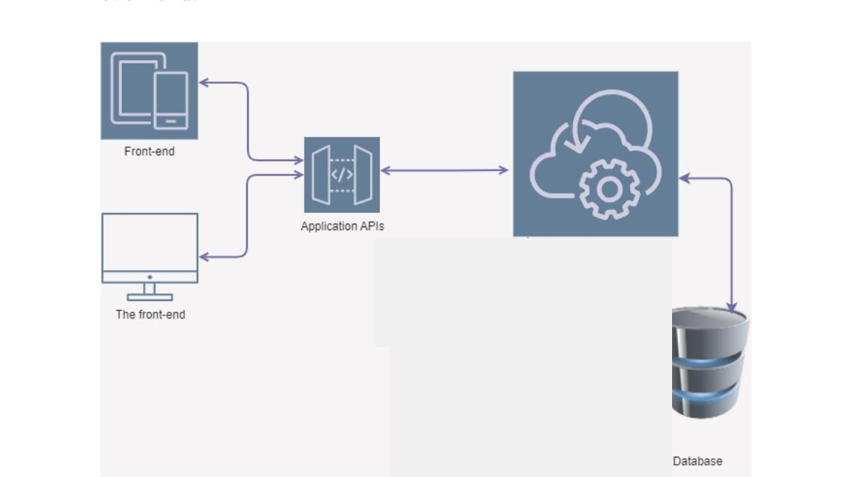
Application Architecture

Slide 10
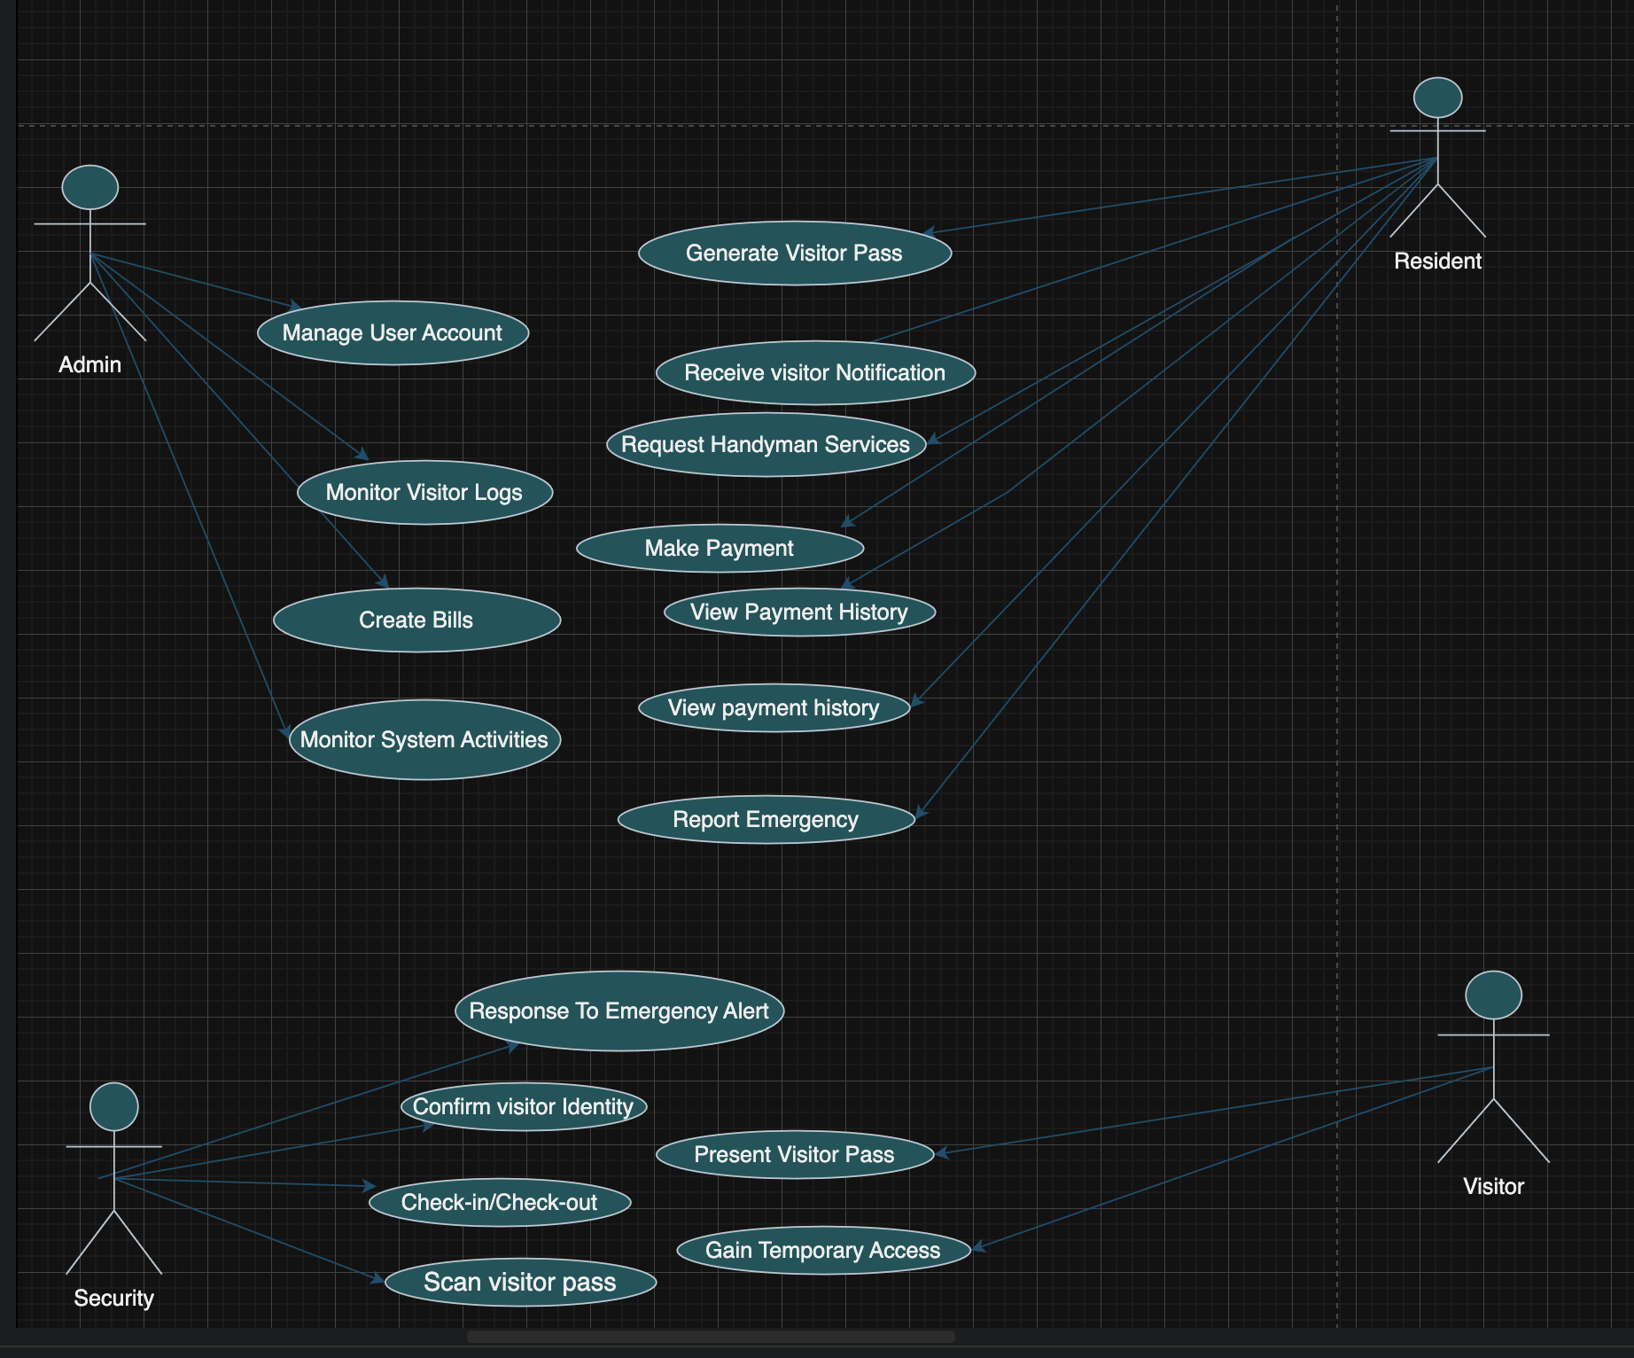
Use Case Diagram

Slide 11
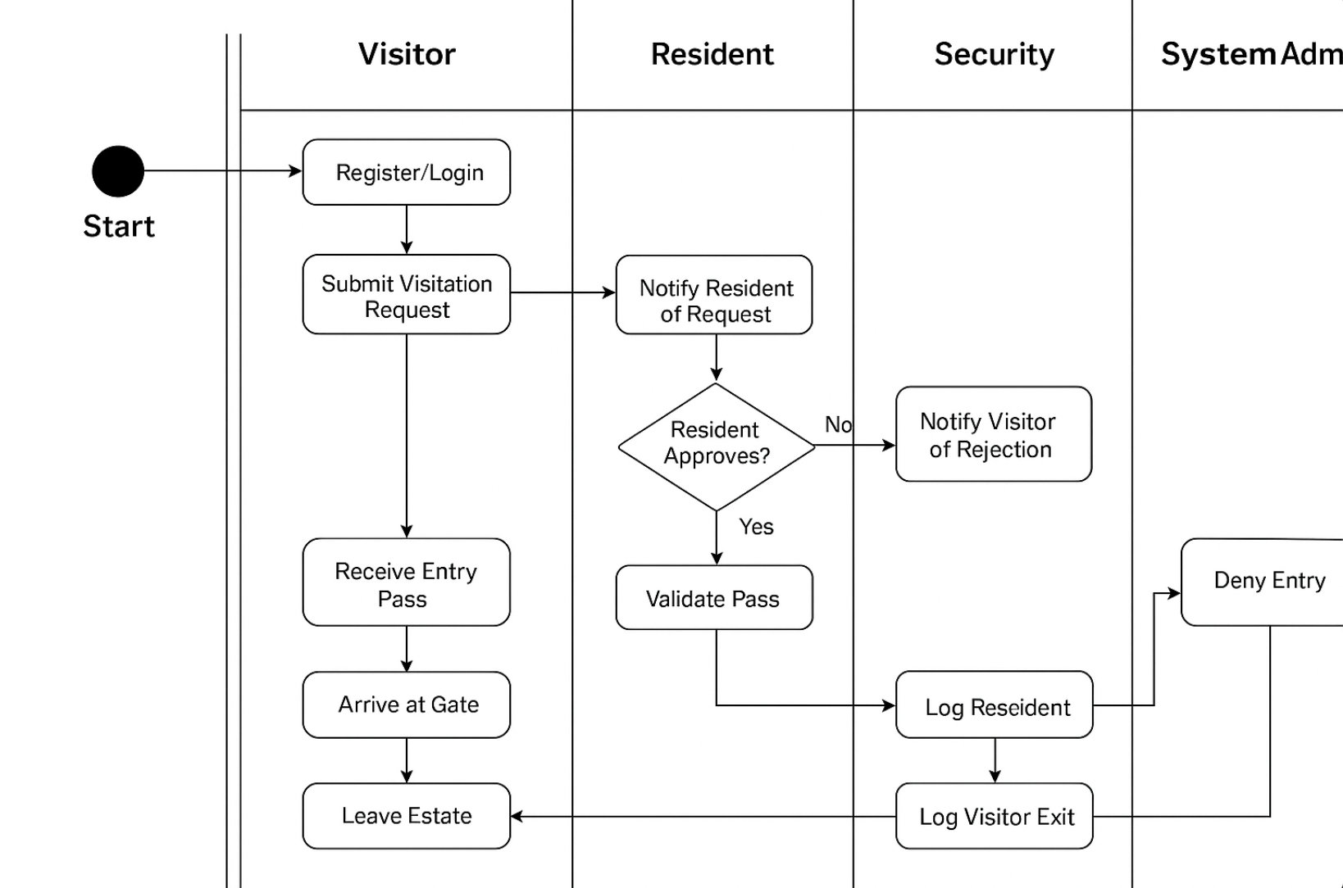
Control flow Diagram

Slide 12
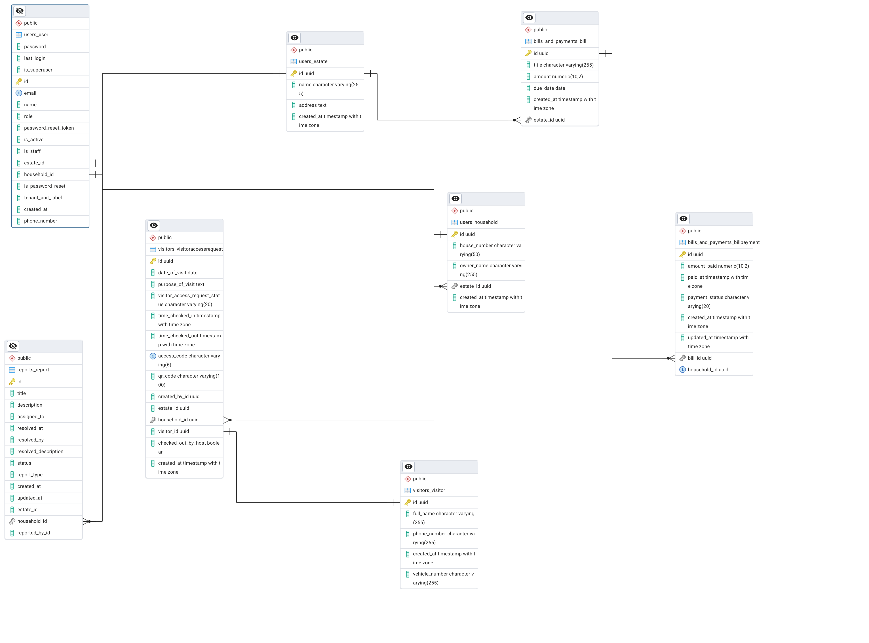
Entity Relationship Diagram

Slide 13
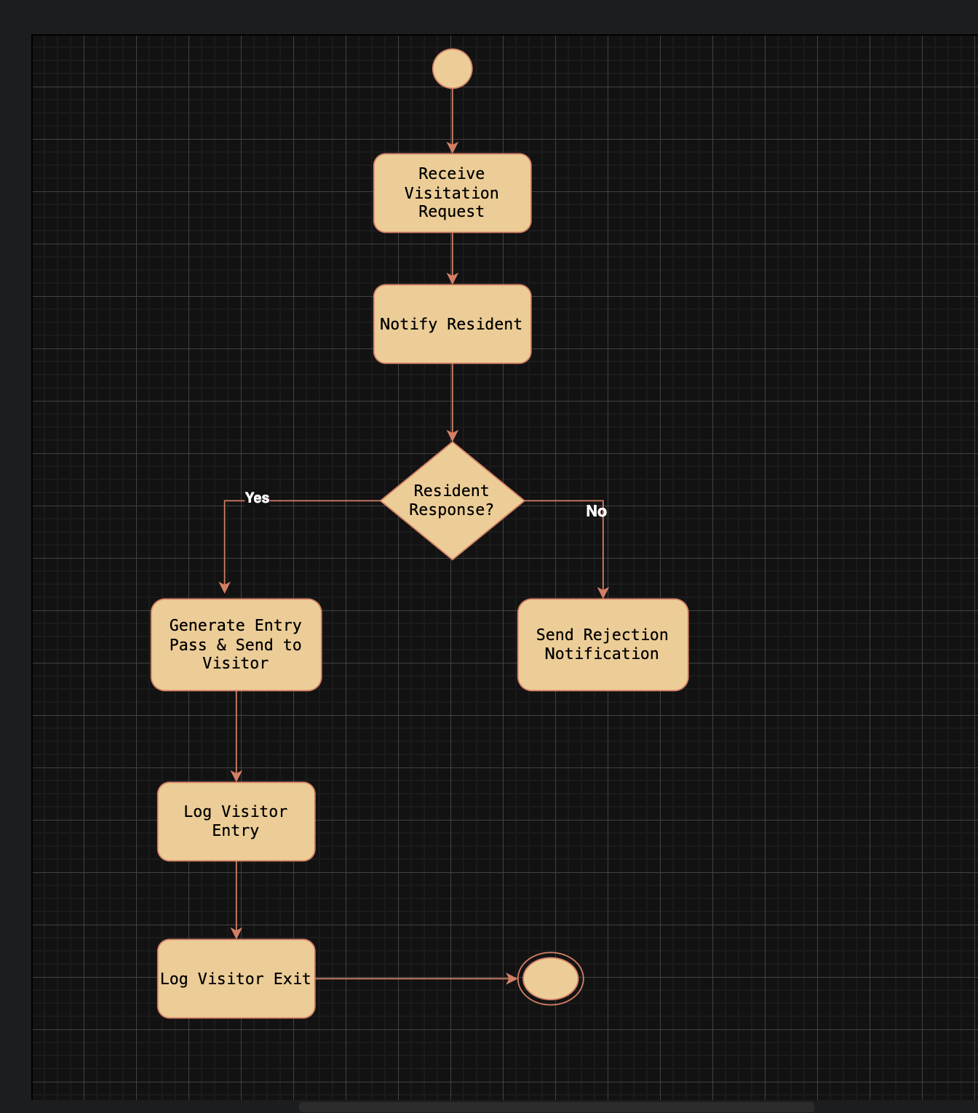
Admin Activity Diagram

Slide 14
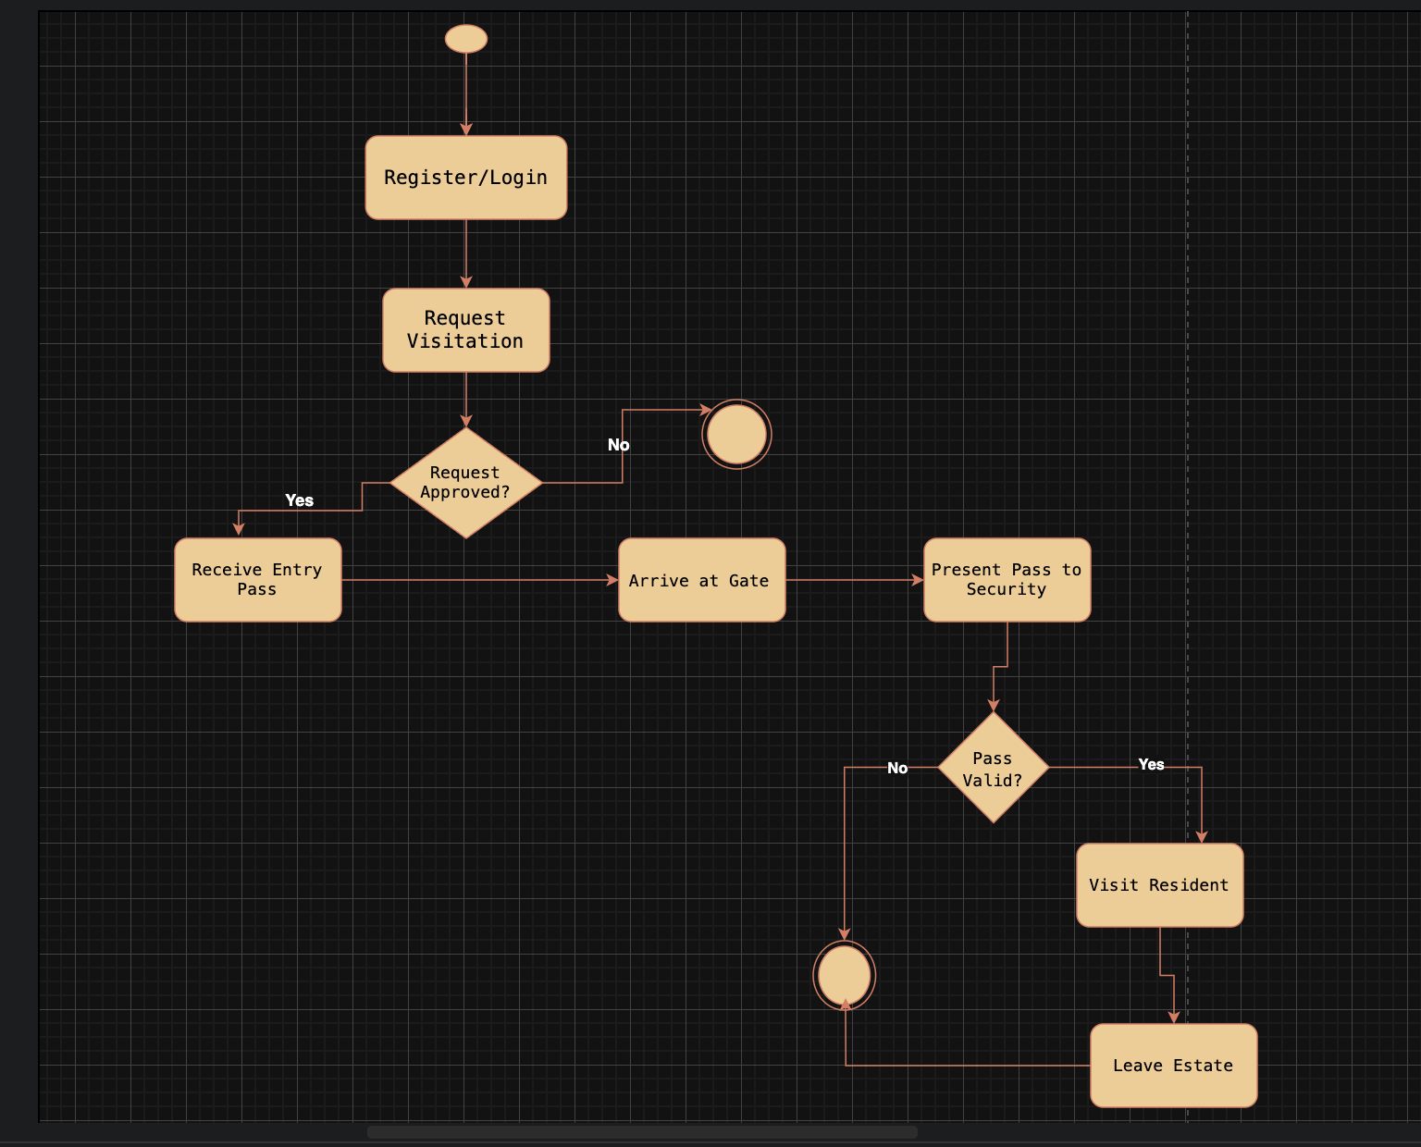
Visitor Activity Diagram

Slide 15
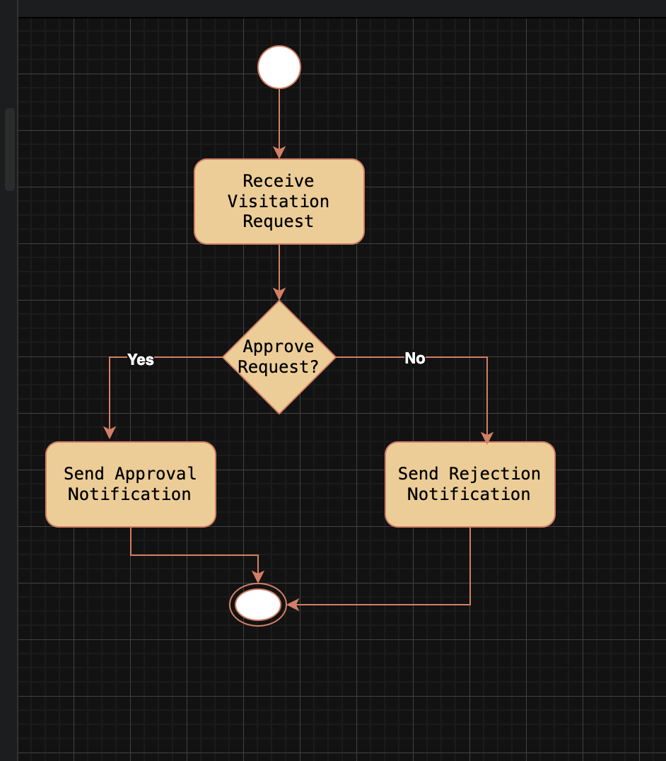
Resident Activity Diagram

Slide 16
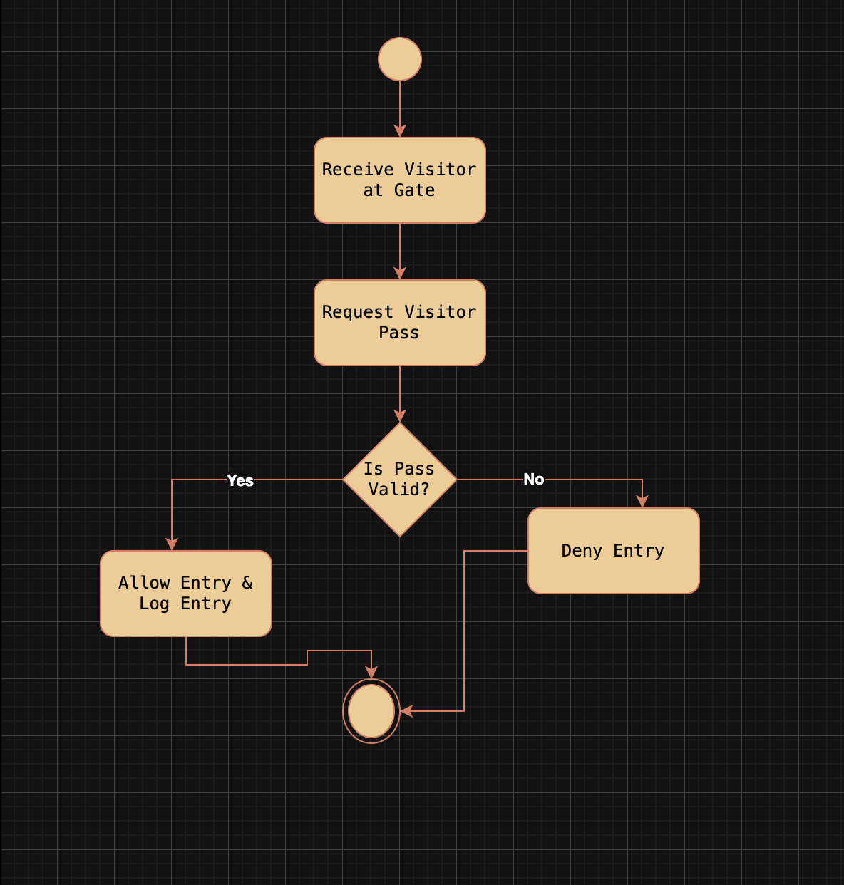
Security Activity Diagram

Slide 17
Tools Techniques and Technologies
StarUML
Workbench
Draw.oi
Visual studio code
Git-Hub
Python
Django Rest Framework
Next.js
React Native
PostgreSQL

Slide 18
Functional Requirements
Req. No | Description | Type
R-001 | The resident shall be able to register and log in. | Functional
R-002 | The residents shall be able to generate visitor pass using QR codes | Functional
R-003 | The security personnel shall be able to scan and verify visitor codes at the gate. | Functional
R-004 | The Admin shall be able to revoke or approve visitor access at the gate. | Functional
R-005 | The resident shall be able to receive real time notification upon arrival of their visitor. | Functional
R-006 | The resident shall be able to report any emergency incident. | Functional
R-007 | The admin shall be able to send estate wide notification to all users. | Functional
R-008 | The admin shall be. Able to manage residents data and records. | Functional
R-009 | The system shall be able to provide a dashboard for admin to monitor estate activities. | Functional

Slide 19
Non-functional Requirements
Req. No | Description | Type
R-001 | The system shall ensure user privacy and data security. | Security
R-002 | The system shall be available 24/7. | Availability
R-003 | The system shall be mobile responsive. | Usability
R-004 | The system shall be good looking and have user friendly interface. | Usability
R-005 | The system shall be able to handle large users without system degradation. | Performance
R-006 | The system shall adhere to provided guidelines regarding user data protection. | Compliance

Slide 20
Test Plan and Results
Test Case ID | Test Description | Status
TC-01 | Create resident or security account by Super Admin | Pass
TC-02 | Reject duplicate account with already, Registered details | Pass
TC-03 | Log in with valid details (Admin, Security and Residents) | Pass
TC-04 | Reject log in with invalid credentials | Pass
TC-05 | Request visitation by visitor and QR generation | Pass
TC-06 | Approve or reject visitation by resident | Pass
TC-07 | Scan visitor QR code at the gate for check in | Pass
TC-08 | Scan visitor QR code at the gate for check out | Pass
TC-09 | Deny entry when QR code is invalid or denied | Pass
TC-10 | Admin create, view and manage bills for residents | Pass
TC-11 | Admin view and manage residents visitors logs and history | Pass
TC-12 | Prevent unauthorized access to pages/routes | Pass

Slide 21
Project Limitations
unable to obtain user GPS coordinates for more accurate tracking of visitor whereabouts.
The resident-handyman service request module's picture upload feature is still underdeveloped.
Residents and security personnel can view real-time updates on "Online" or "Offline" status indications.
Instantaneous email alerts for visitation updates, bill production, and approvals.
scan barcodes or QR codes.
Overall estate Announcement is also underdeveloped

Slide 22

Thank you

